Slide 1
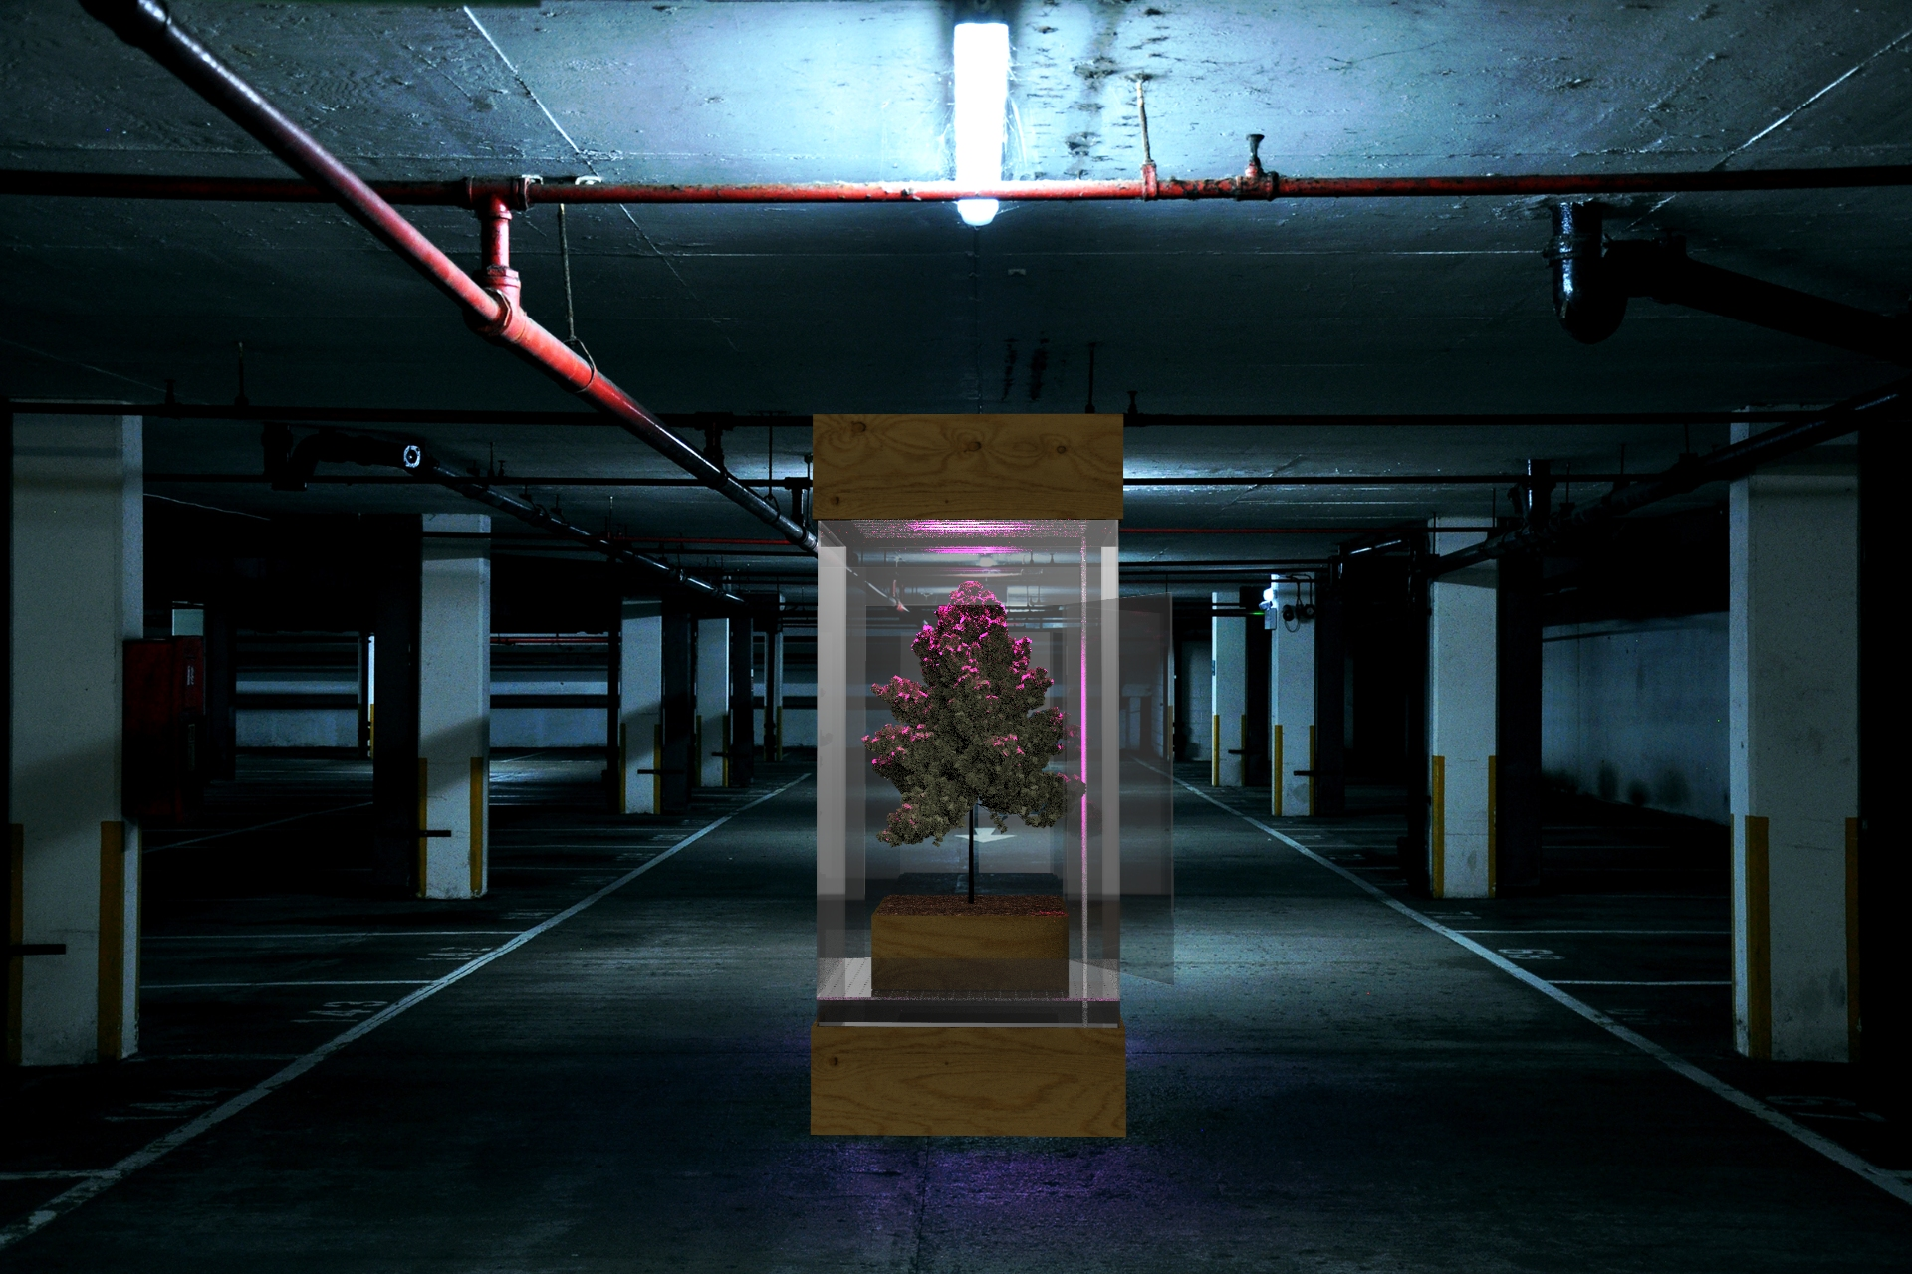


º
POWAR
Plant Observatory of Weather Adaptability for Resilience.
Pablo Zuloaga Betancourt

Slide 2

01
The world we live in

Slide 3
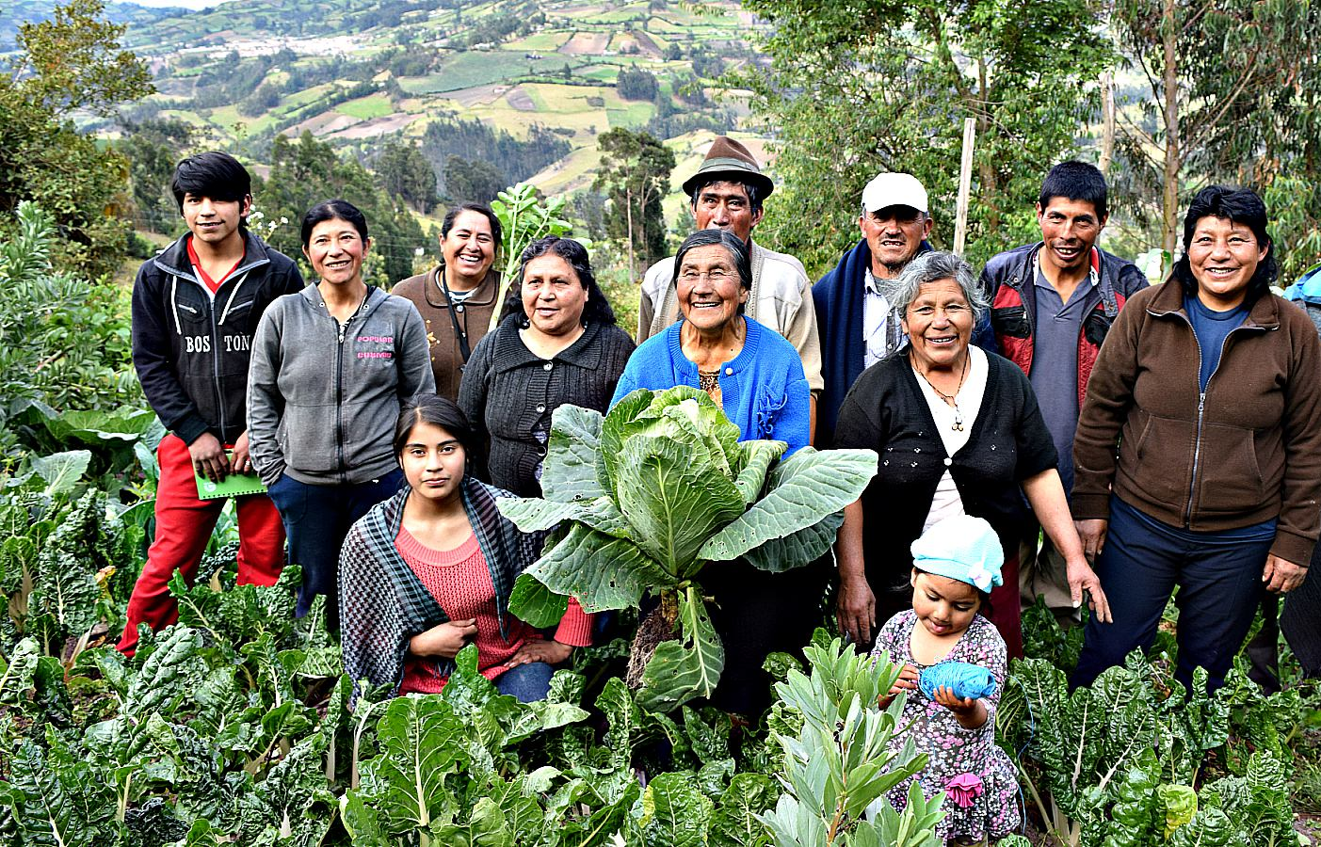

2/3
Of the world poorest population, work in something related to agriculture.
Notes:
ESO EN OTRAS PALABRAS SIGNIFICA QUE LA GENTE QUE LLEVA LOS ALIMENTOS A NUESTRA MESA, VIVEN CON MENOS DE 2 DÓLARES DIÁRIOS.

Slide 4
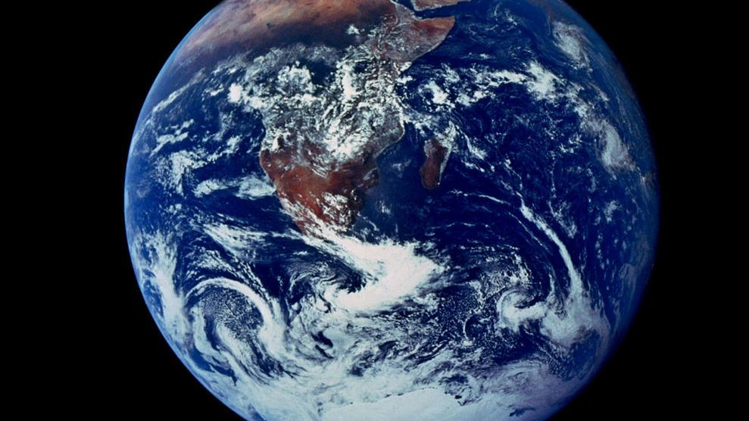
70%
We will have to produce 70% more food than we produce nowadays
Notes:
ESO EN OTRAS PALABRAS SIGNIFICA QUE LA GENTE QUE LLEVA LOS ALIMENTOS A NUESTRA MESA, VIVEN CON MENOS DE 2 DÓLARES DIÁRIOS.

Slide 5
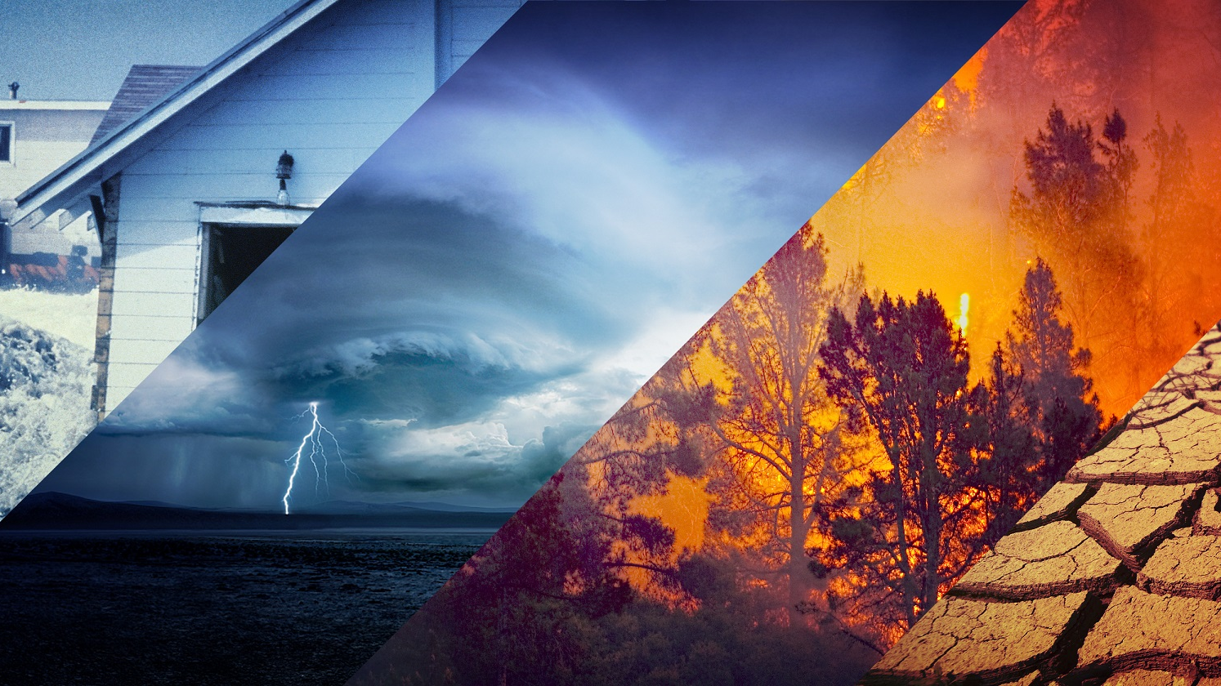
Earth
Temperature could rise 3.4º generating extreme climates throughout the planet.
Notes:
ESO EN OTRAS PALABRAS SIGNIFICA QUE LA GENTE QUE LLEVA LOS ALIMENTOS A NUESTRA MESA, VIVEN CON MENOS DE 2 DÓLARES DIÁRIOS.

Slide 6
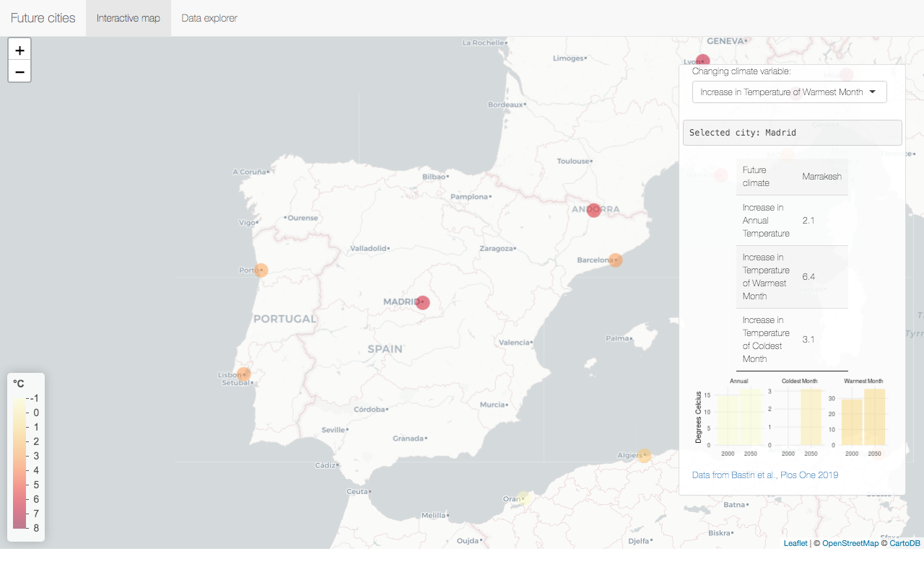

By 2050
London is supposed
to have a weather similar to Barcelona, and Madrid to Marrakesh.
Notes:
5770 Cities in the USA broke heat records
in June 2021

Slide 7
02
The project

Slide 8
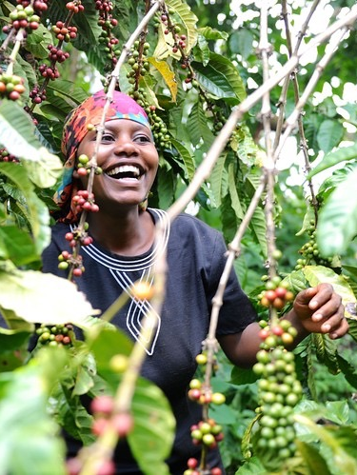
What if we could anticipate the effects of climate change and move into future proof farming practices?

Slide 9
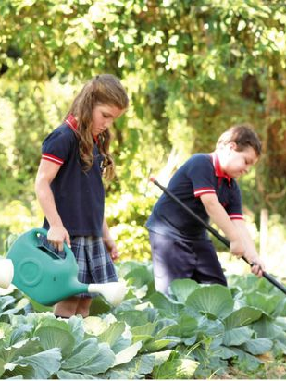
What if we could grow the food we grow today with our future climate
by 2050?

Slide 10
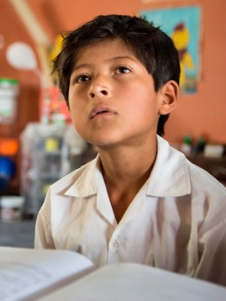
What if we could teach environmental science in a more practical way?

Slide 11
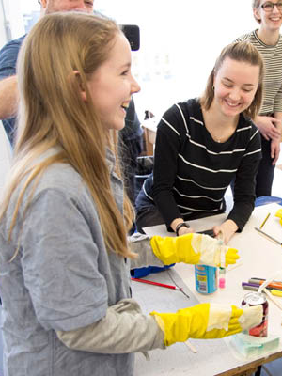
And share our experiments with schools and farmers around the world to make them more resilient?

Slide 12

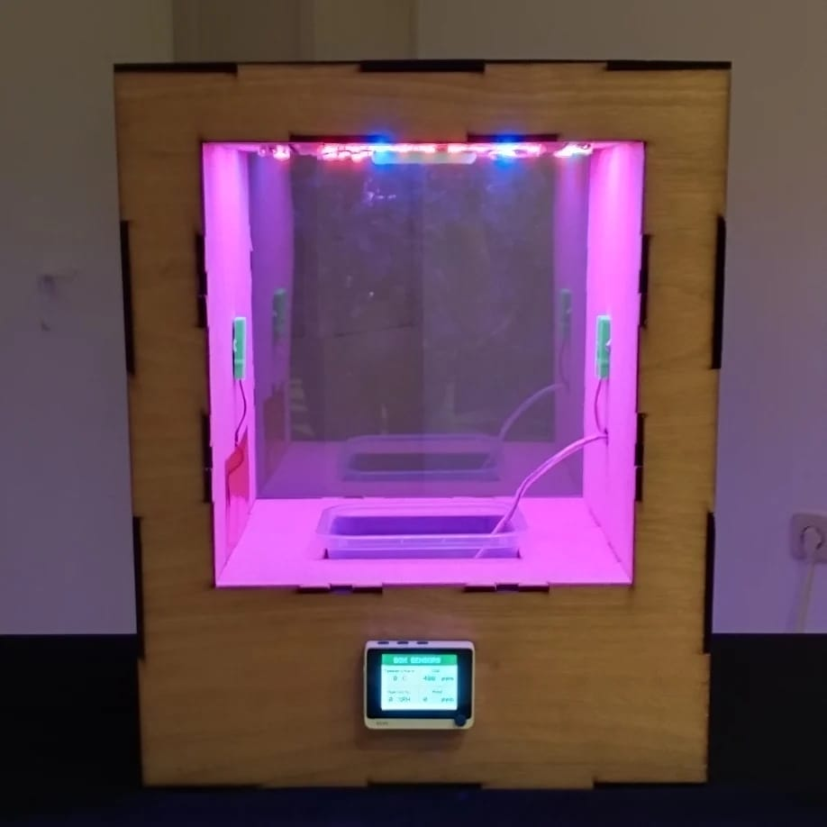


A Low-Cost, Open Source, climate simulator to grow food under different wheatear conditions for experimentation and education.

Slide 13
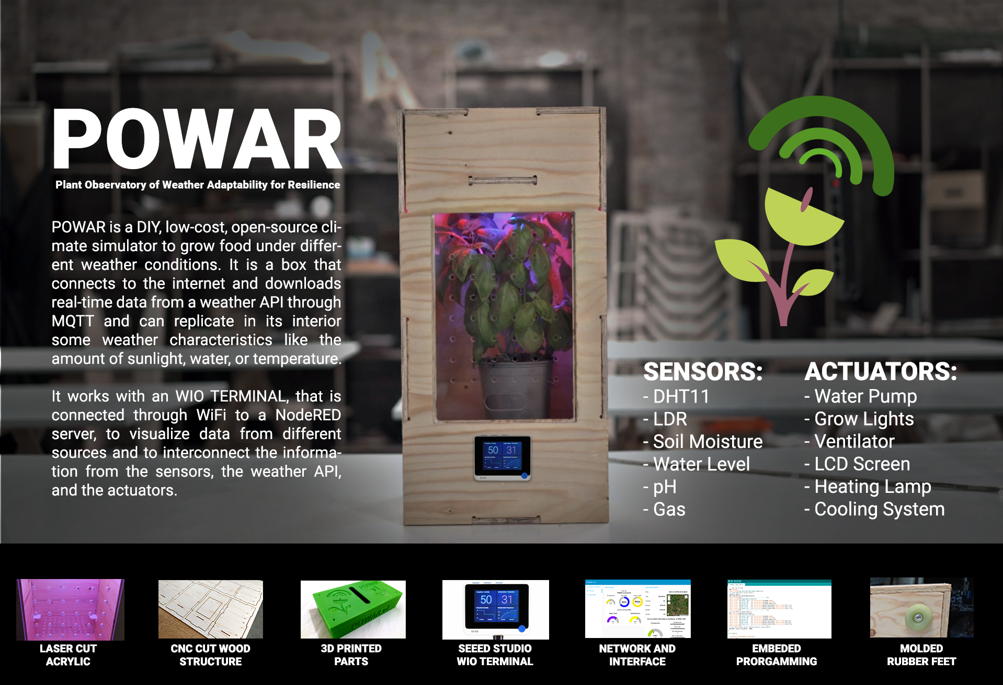
POWAR
Version 1
(2019)

Slide 14
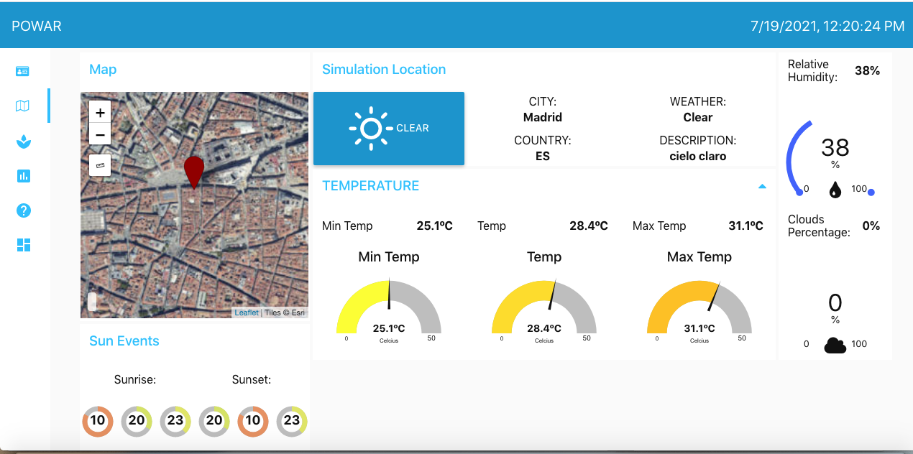
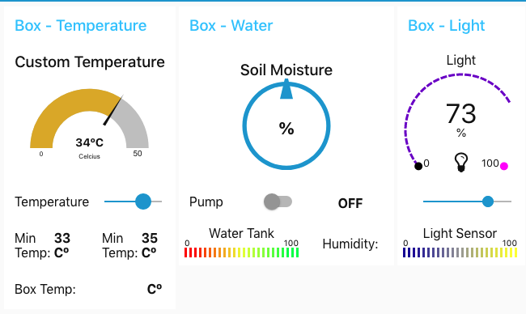


How it works?
It connects to the internet and reviews the weather information for a city selected by the user.

Slide 15
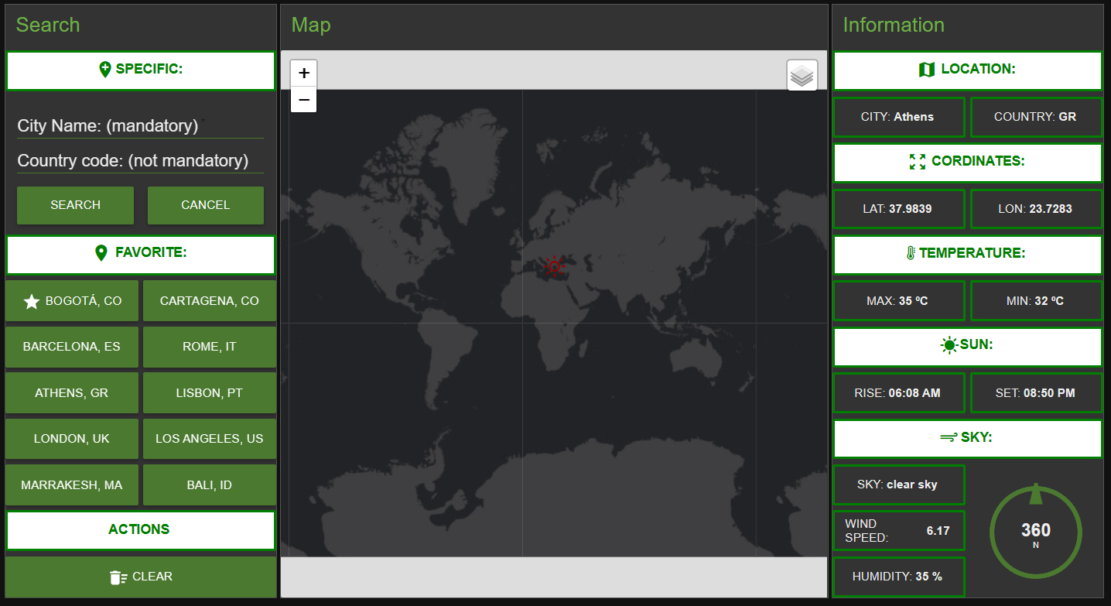

Slide 16

How it works?
Then it compares it with the information from the sensors inside the box.

Slide 17
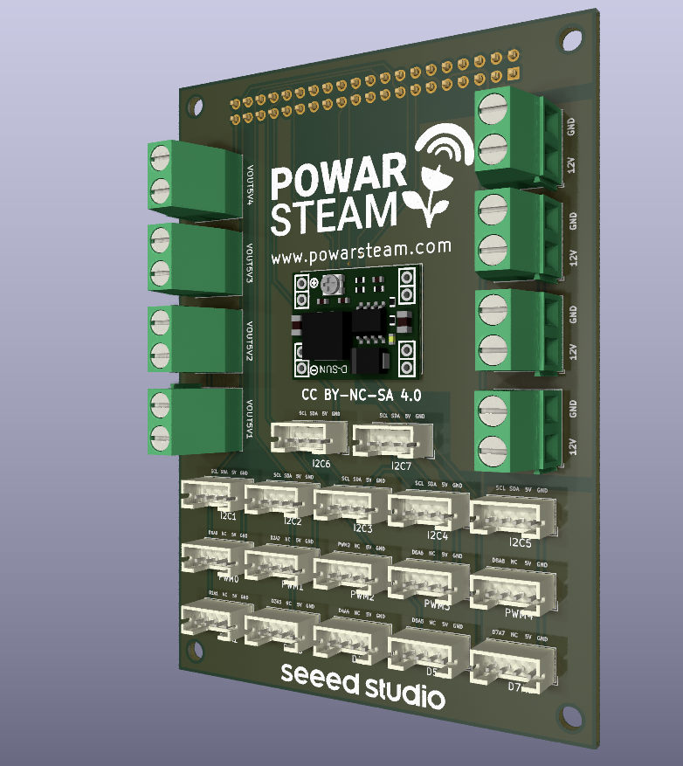
How it works?
The sensors are connected to an IoT board we designed, that its being produced by Seeed Studio at this moment.

Slide 18
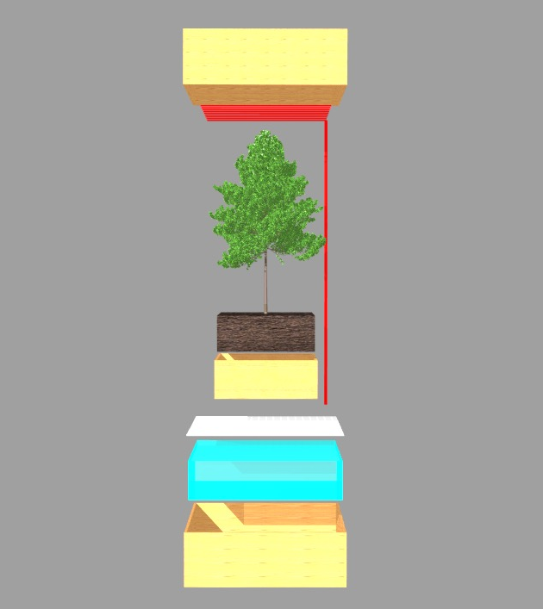

How it works?
It regulates the conditions inside to simulate some characteristics of that climate.

Slide 19
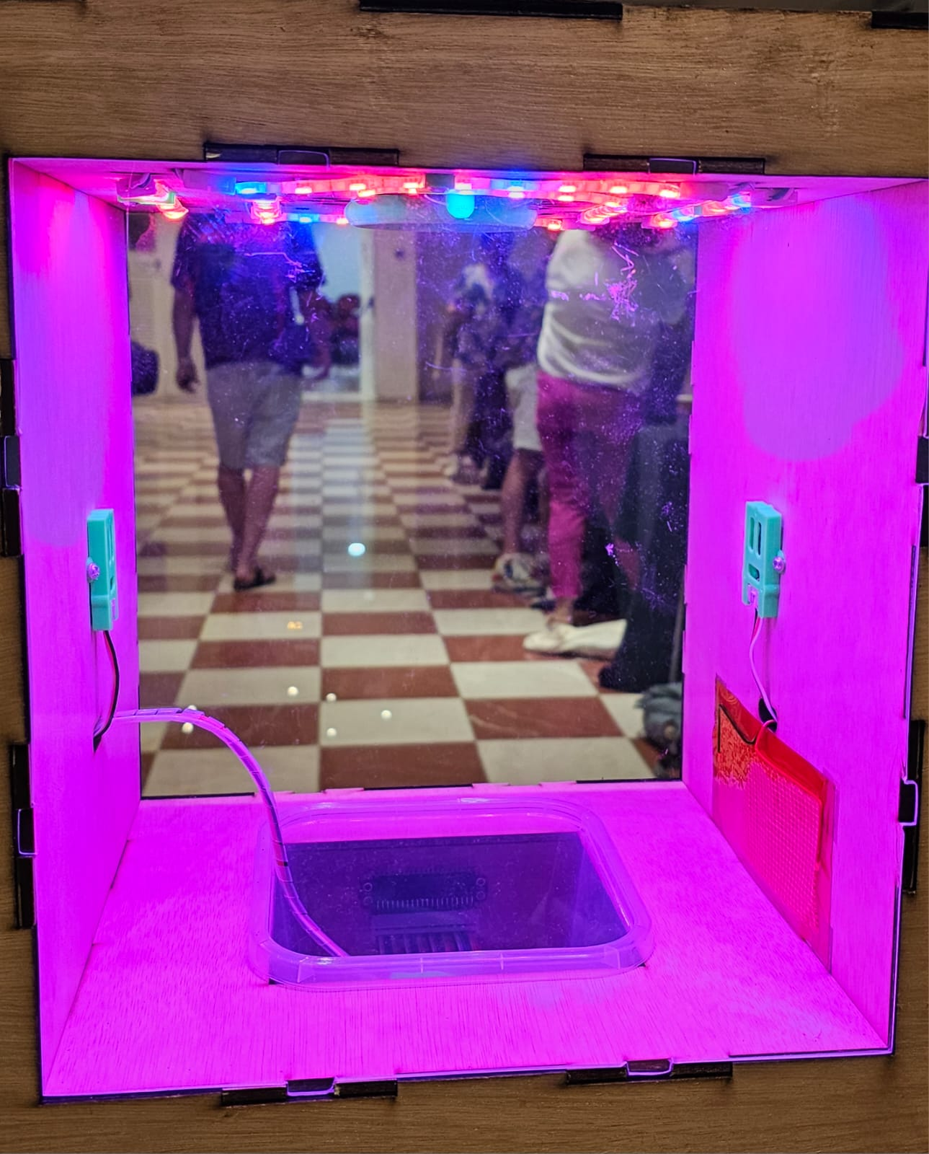
How it works?
It can take the temperature +20ºC
and -5ºC of the physical location weather.

Slide 20
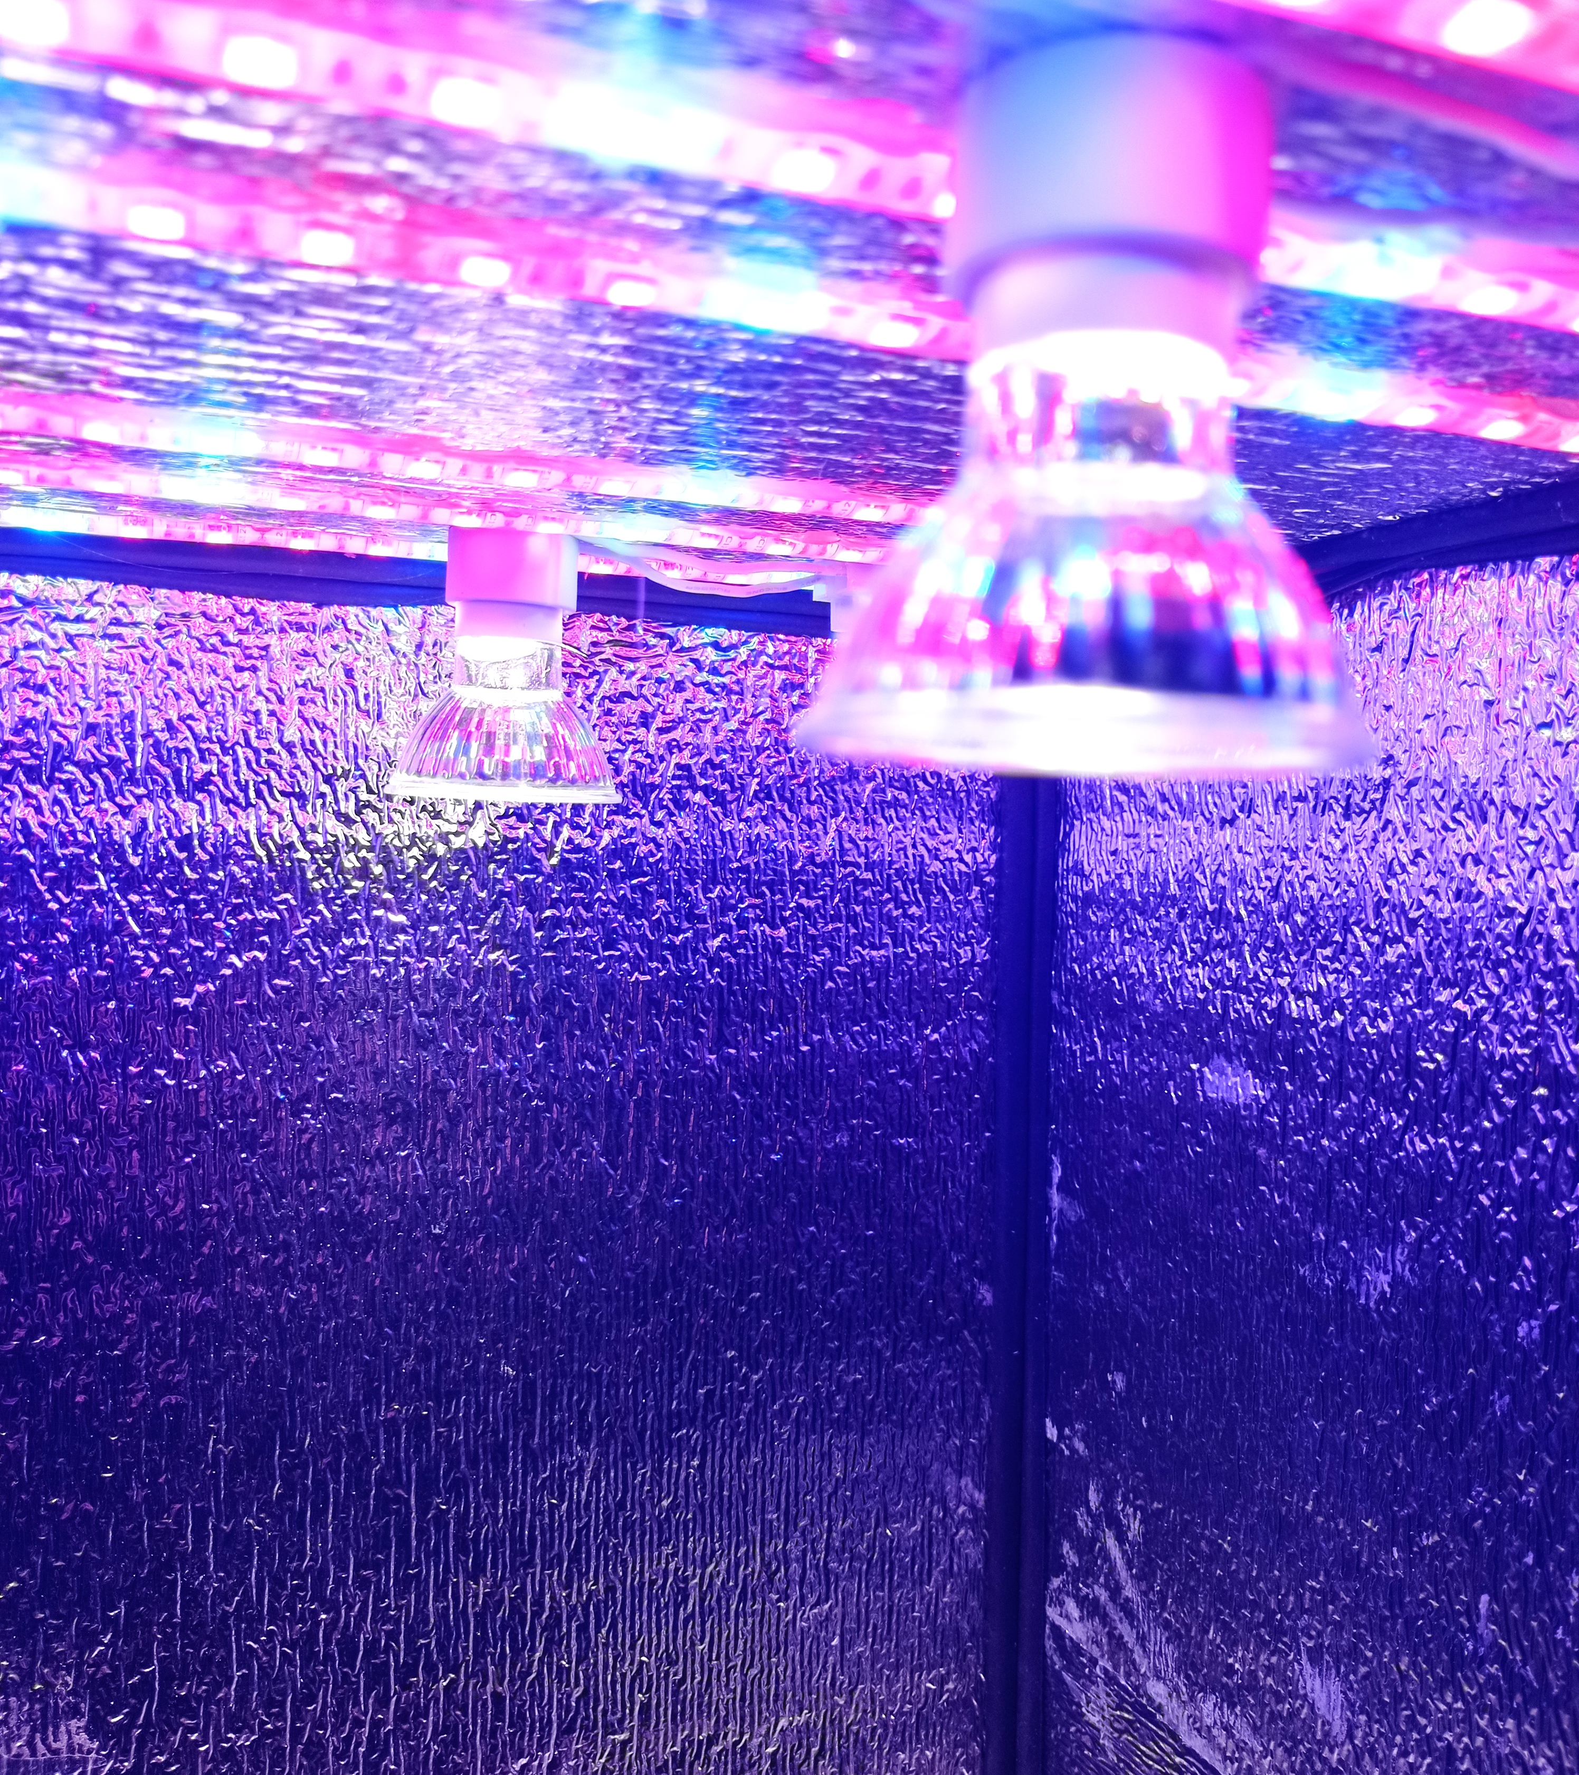
How it works?
It replicates the sunlight intensity considering the time of the day, season, latitude, and cloud effects.

Slide 21
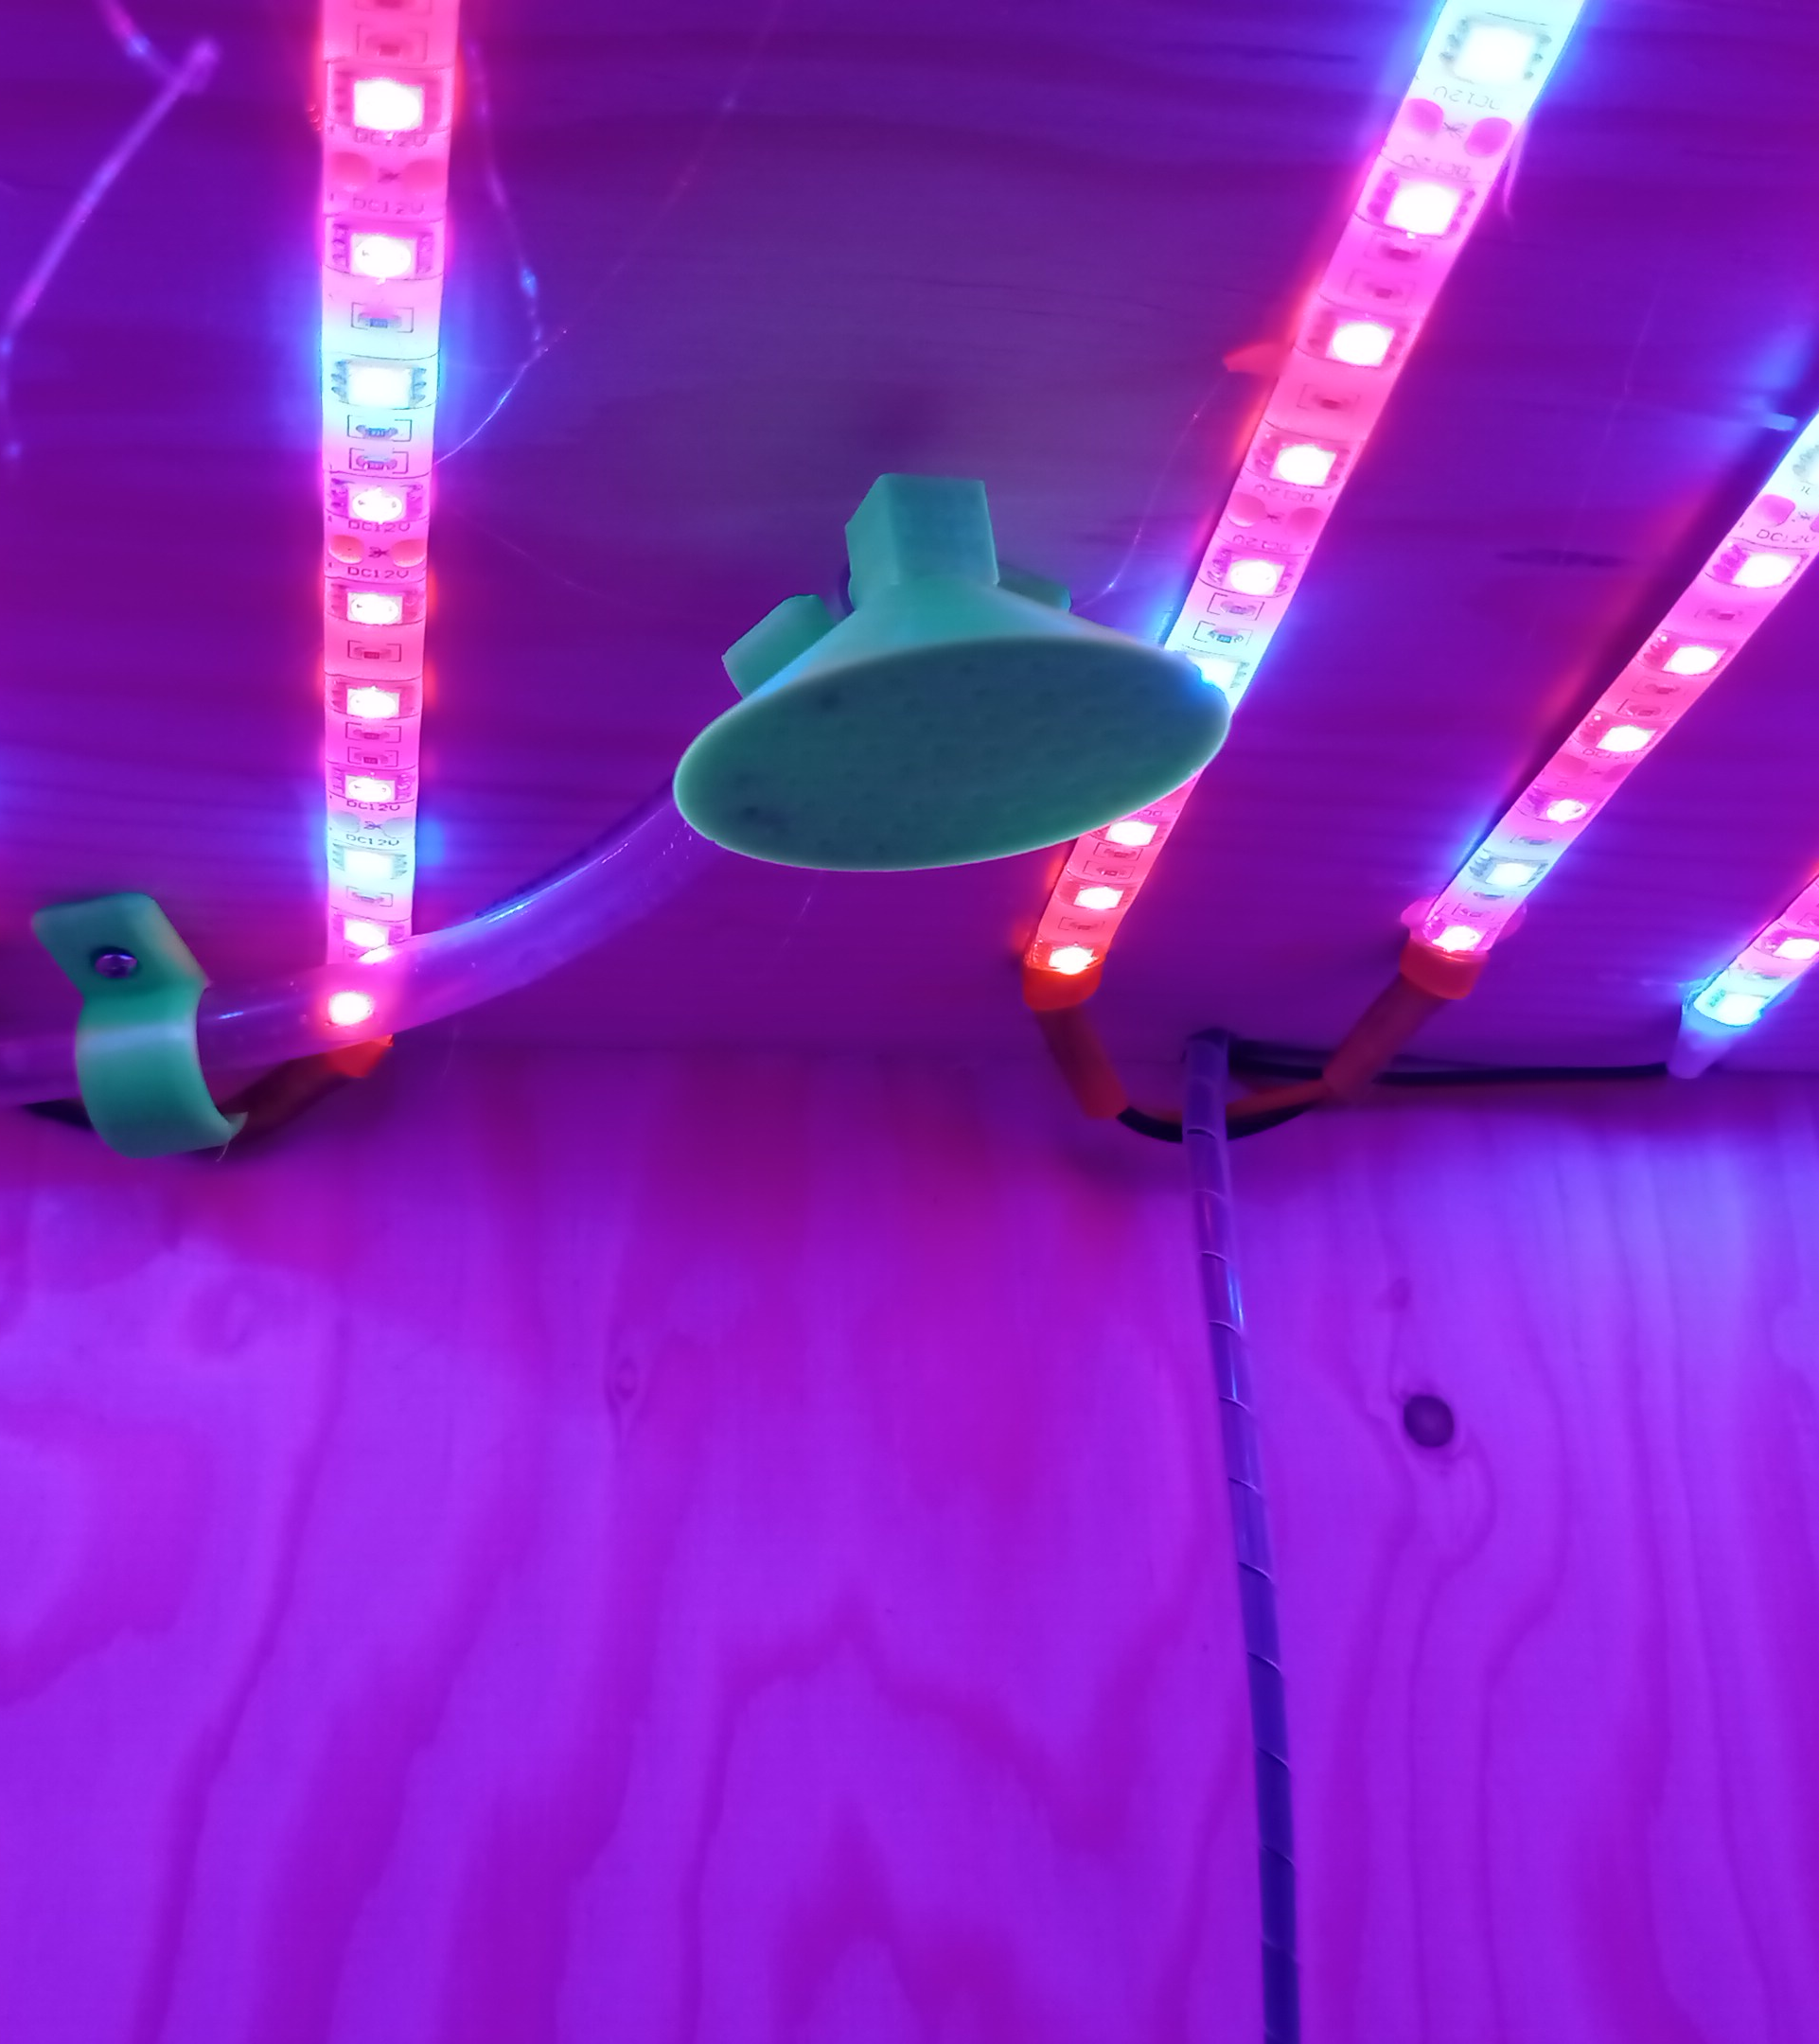
How it works?
It can also simulate the rain if its happening in the location, by its intensity and frequency.

Slide 22
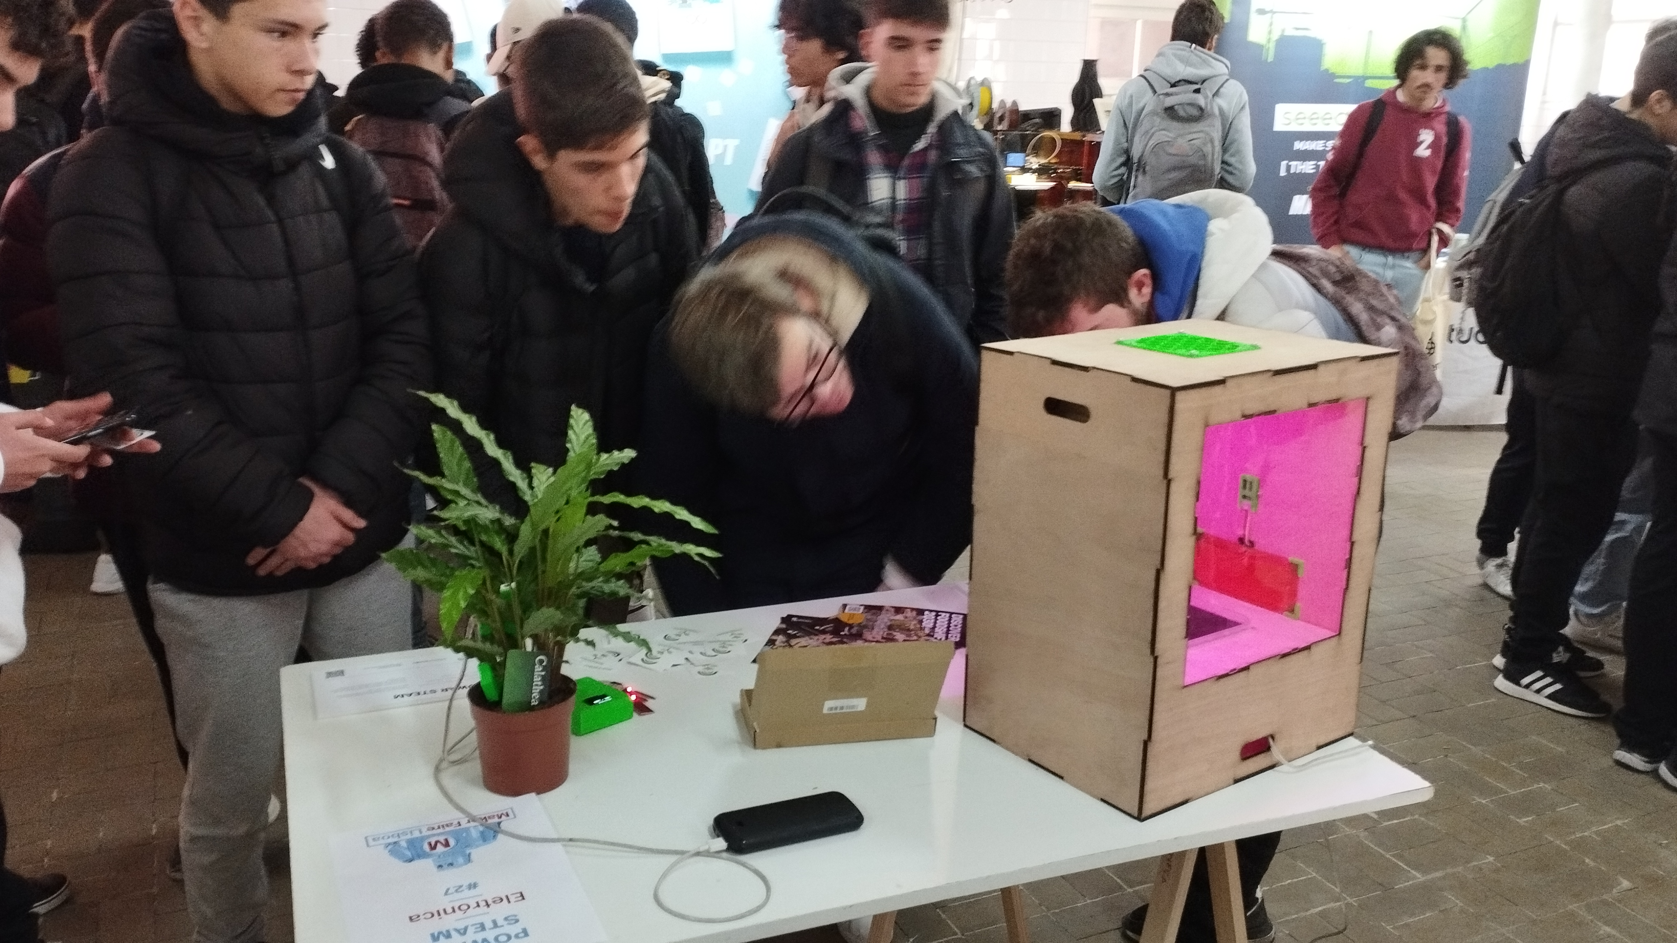
Lisbon Maker Faire 2023
(Portugal)

Slide 23
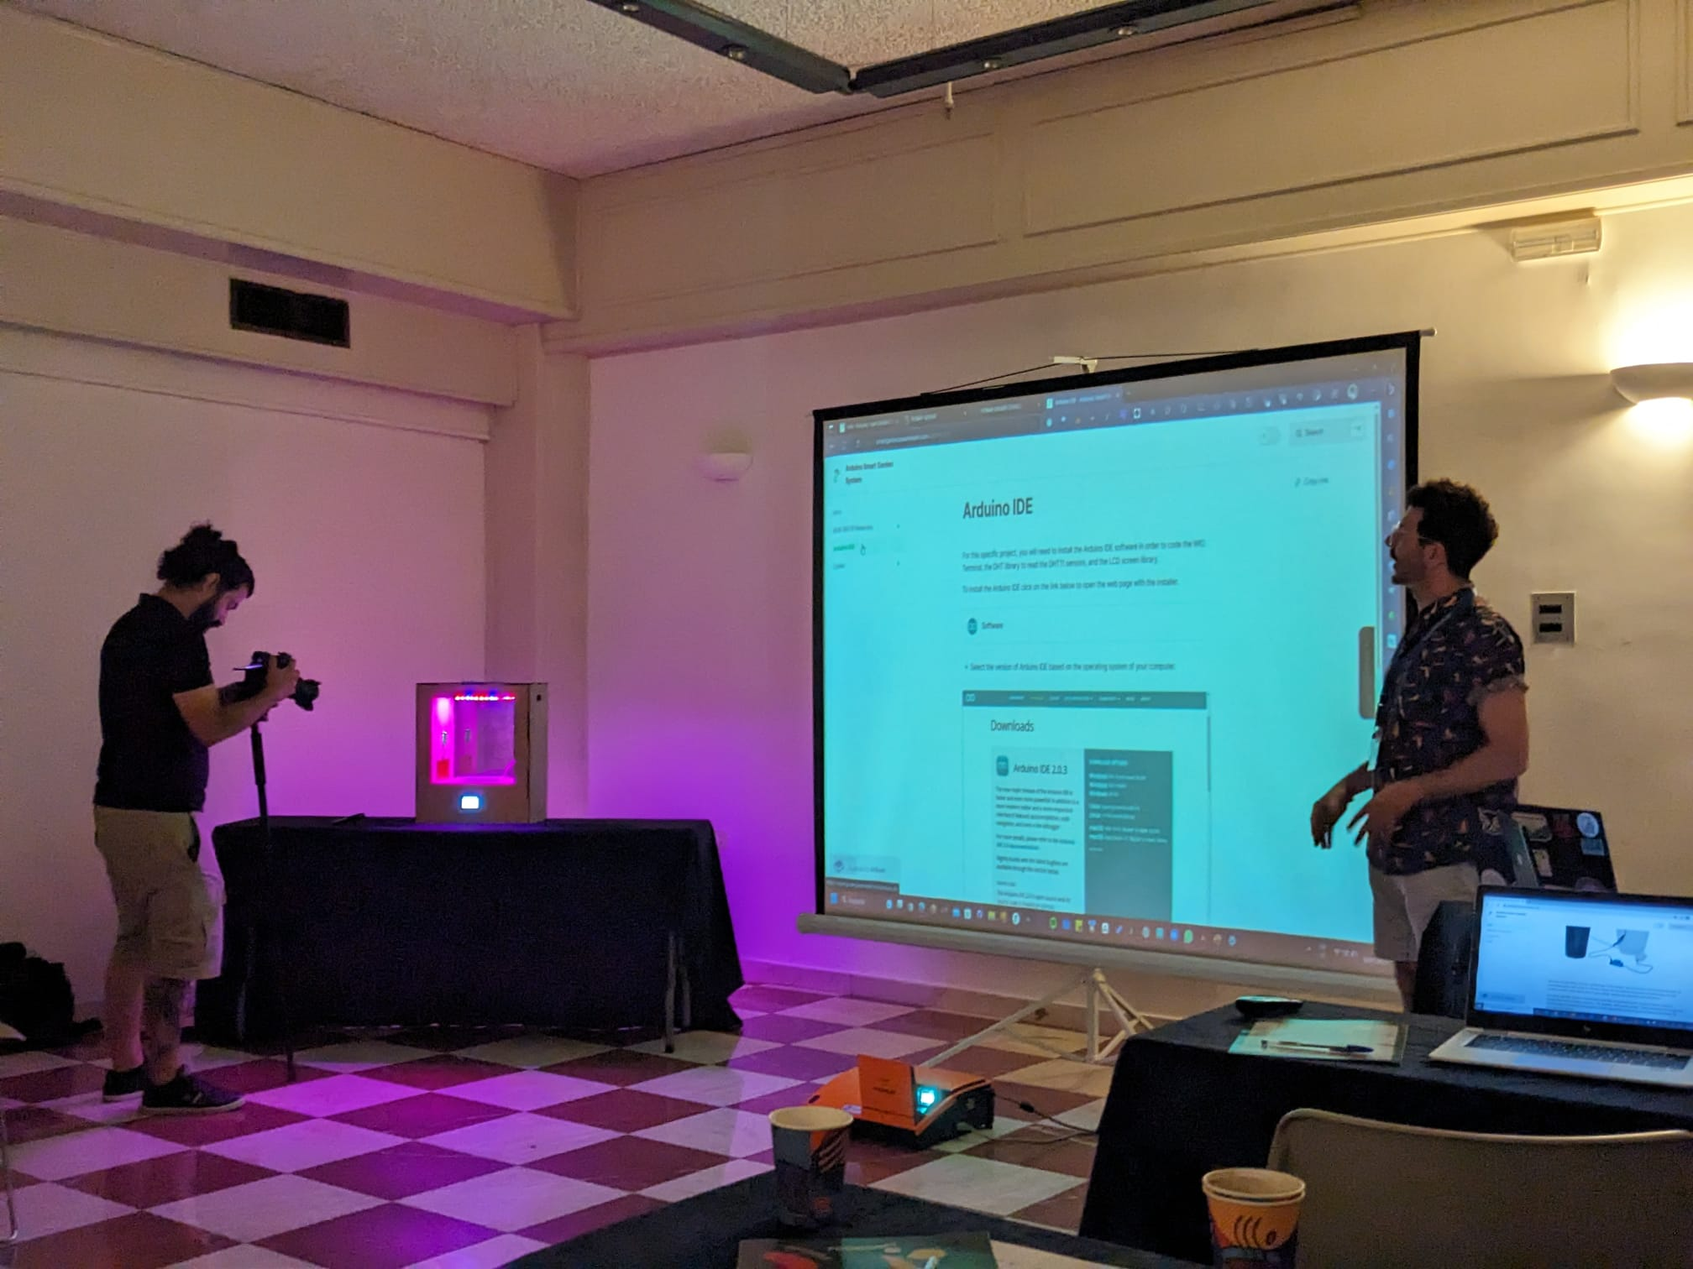
FoodShift SummerSchool 2023 (Greece)

Slide 24
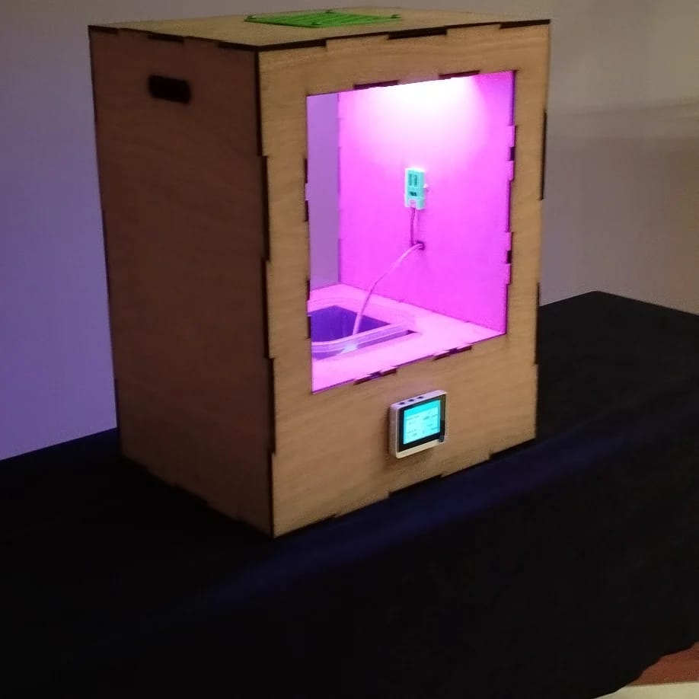
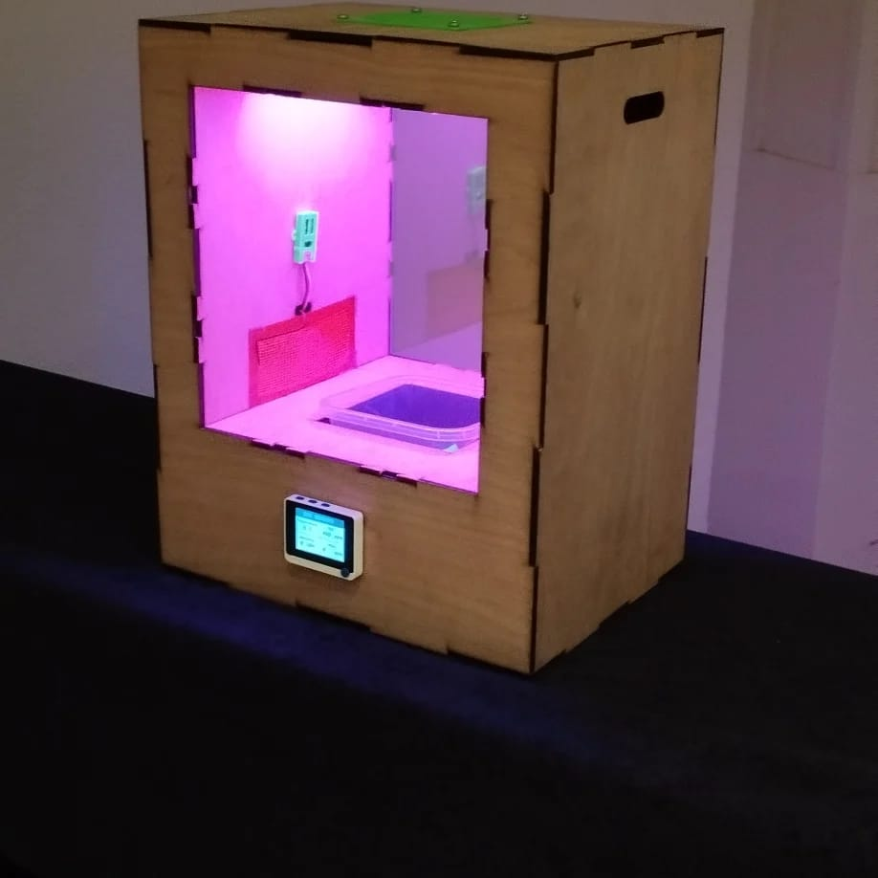
Latest Version

Slide 26











Seasonal School Gardens
Environmental Sensors
Environmental Experimentation
Electronics
(Arduino)
The climate simulator is part of a planet-centered technological learning experience that mixes digital fabrication, IoT and environmental science, in a series of experiments designed for different learning levels in school.
Continuos at home Experimentation
Coding and programming
Multi-device
Content
3D Printing
Global Network
of Open Knowledge
Digital Fabrication
(CNC / Laser Cut)

Slide 27
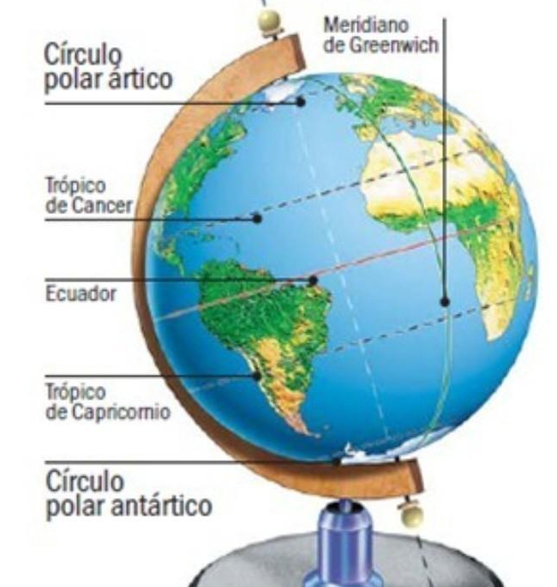
Poles and Hemispheres
For this experiment we will grow a summer plant, simulating the climate of a city in the opposite hemisphere, while we are in winter.
CONCEPTS: Latitude, Longitude, Hemispheres, Poles, Tropic, Continents, Humidity, Temperature.
Did you know that while we are in winter, on the other side of the world it is summer?
https://travesiasdigital.com/destinos/diferencias-entre-los-hemisferios-norte-y-sur

Slide 28
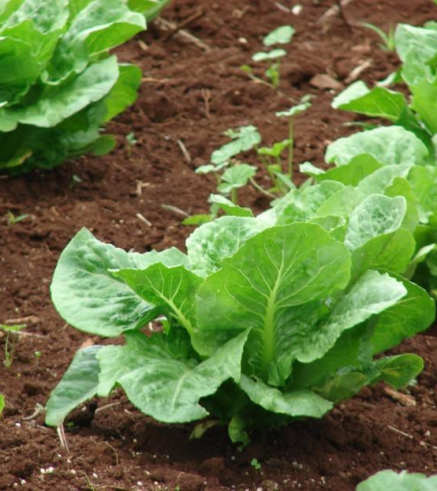
Growing LETTUCE IN THE SAHARA
This is an experiment in which
we will test what will happen we grow a lettuce in a very hot environment, with long sunny times and little rain as is North Africa.
CONCEPTS: Climate change, extreme temperatures, desert ecosystems, global warming.
Did you know that although plants need sun and heat for their growth, excess heat can also scorch them?
https://jardinessinfronteras.com/2017/12/12/algunas-frutas-tropicales/

Slide 29
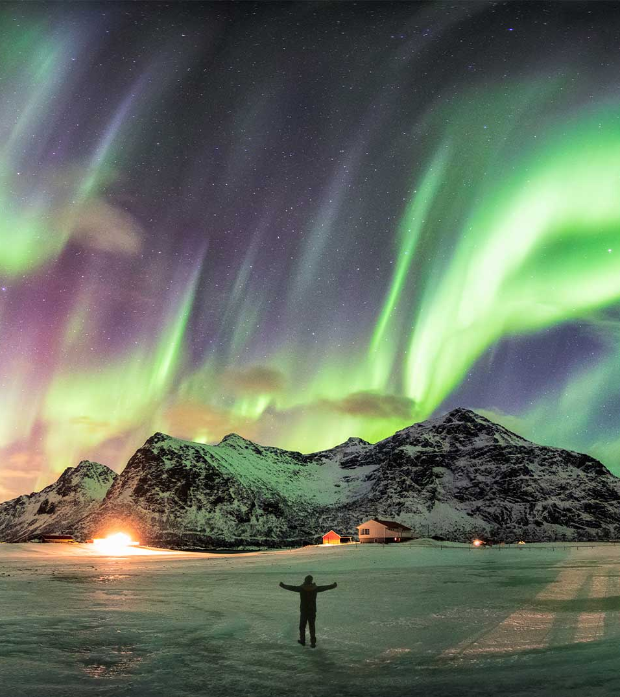
Light times and shade
This is an experiment in which
we will test how the sun is shared according to the latitude at which we are analyzing how it behaves at the poles, temperate zones and inter-tropical zones.
CONCEPTS: Northern lights, Light spectrum, Moments of light, Light intensity, the sun.
Did you know that there are places in the world that barely receive 4 hours of light during certain times of the year?

Slide 30

HEAT Wet vs dry
In this experiment we will play with the dehumidification or humidification of the air, to see how the same temperature behaves with more or less humidity to understand its effect.
CONCEPTS: Relative humidity, drought, condensation, evaporation, water cycle.
Why do you feel hotter in Barcelona than in Madrid, with Madrid having a higher temperature?

Slide 31

THE FUTURE CLIMATE
In this experiment we will try to grow plants that we currently grow, in the predicted future climate for our region.
CONCEPTS: Climate change, extreme temperatures, future climates, floods, droughts, soil degradation, greenhouse effect.
Did you know that by 2050 London will have a climate like Barcelona, and Madrid like Marrakesh?
https://hooge104.shinyapps.io/future_cities_app/

Slide 32
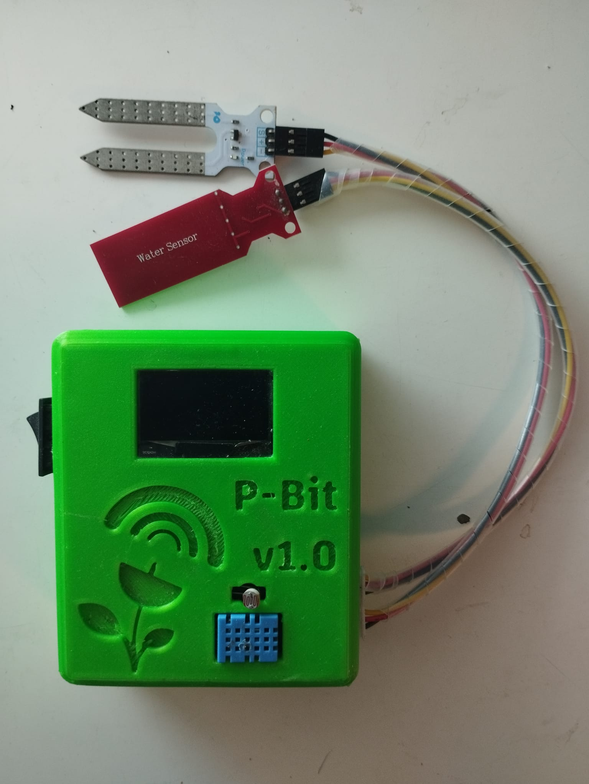

The P-Bit!
A product for personal use by each student, with which they can measure the environment in different ways through sensors.

Slide 33
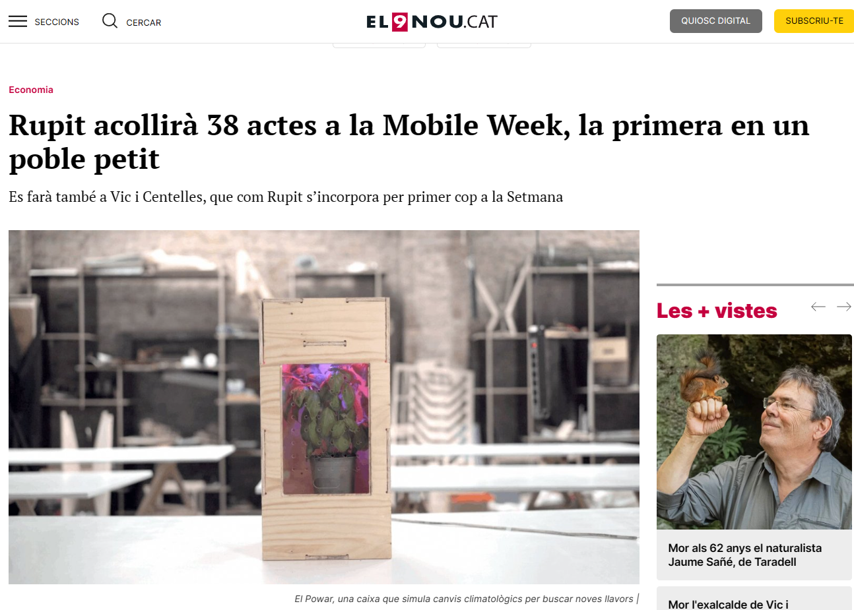
Latest Link:
POWAR – FoodSHIFT 2030
Seeed Studio - LinkedIn
Smart City Expo World Congress
Mobile Week - El 9 Nou

Slide 34

EMPOWER PEOPLE
WITH KNOWLEDGE,
DATA AND TECHNOLOGY,
FOR A PLANET CENTERED
FUTURE.
www.powarstem.com
pabzul@gmail.com

